Slide 1
Cambridge English Exams Independent and Objective Assessment

Slide 2
Cambridge University
Основан в 1209 – один из самых влиятельных университетов,
31 колледж и 150 институтов

Slide 3
Cambridge English Language Assessment
Департамент экзаменов по английскому языку Кембриджского университета
Экзамены на знание английского языка – с 1913 года
Более 4 млн. сдающих по всему миру

Slide 4
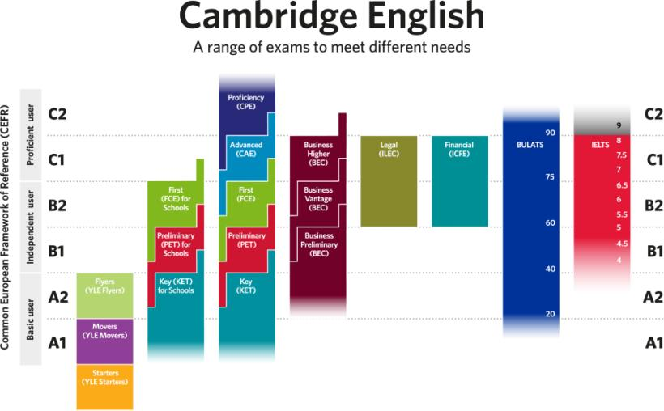

Slide 5
What makes a good language test?
tests all four skills
has positive washback effect
easy to integrate into curriculum
widely recognized
motivating
relates to real life
FAIR and USEFUL

Slide 6
CEFR Levels
Can understand and use familiar everyday expressions and very basic phrases aimed at the satisfaction of needs of a concrete type. Can introduce him/herself and others and can ask and answer questions about personal details such as where he/she lives, people he/she knows and things he/she has. Can interact in a simple way provided the other person talks slowly and clearly and is prepared to help.
Can understand the main ideas of complex text on both concrete and abstract topics, including technical discussions in his/her field of specialization. Can interact with a degree of fluency and spontaneity that makes regular interaction with native speakers quite possible without strain for either party. Can produce clear, detailed text on a wide range of subjects and explain a viewpoint on a topical issue giving the advantages and disadvantages of various options.
Can understand the main points of clear standard input on familiar matters regularly encountered in work, school, leisure, etc. Can deal with most situations likely to arise whilst travelling in an area where the language is spoken. Can produce simple connected text on topics which are familiar or of personal interest. Can describe experiences and events, dreams, hopes and ambitions and briefly give reasons and explanations for opinions and plans.
Can understand sentences and frequently used expressions related to areas of most immediate relevance (e.g. very basic personal and family information, shopping, local geography, employment). Can communicate in simple and routine tasks requiring a simple and direct exchange of information on familiar and routine matters. Can describe in simple terms aspects of his/her background, immediate environment and matters in areas of immediate need.
Can understand a wide range of demanding, longer texts, and recognize implicit meaning. Can express him/herself fluently and spontaneously without much obvious searching for expressions. Can use language flexibly and effectively for social, academic and professional purposes. Can produce clear, well-structured, detailed text on complex subjects, showing controlled use of organizational patterns, connectors and cohesive devices.
A1
B2
B1
A2
C1

Slide 8
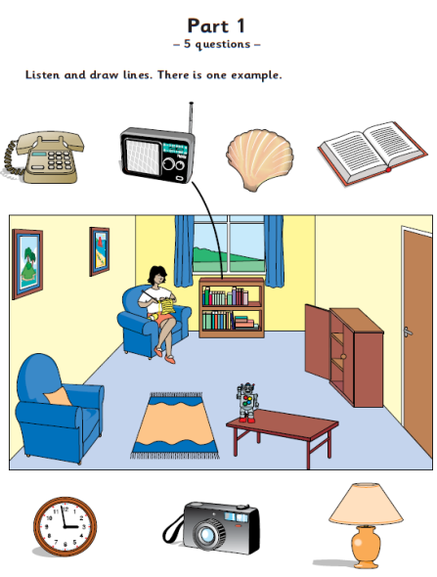
Аудирование
состоит из 4 частей
и длится 20 минут.
Все тексты
проигрываются дважды.
Starters listening
Пример задания 1:
Прочертить линию
от названного предмета
к его расположению
на картинке

Slide 9
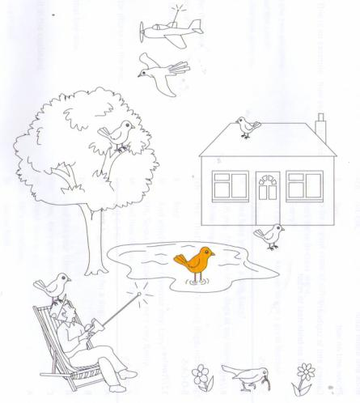
Starters listening
Пример задания 5:
Найти предмет
и раскрасить в соответствующий цвет

Slide 10
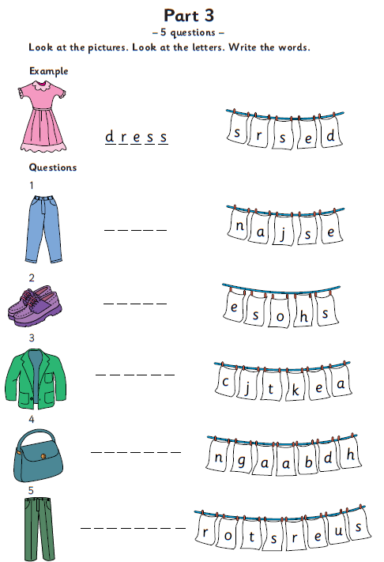
Starters Reading and Writing
Пример задания 3:
Составить правильное
слово из букв

Slide 11
Тест на разговорную речь длится от 3 до 5 минут
и идет один на один (экзаменатор-ребенок)
Starters
Speaking
Пример
задания

Slide 12
Notes:
Show slide: Awards and explain that, in keeping with the ethos of the tests as a positive experience, all candidates receive an attractive award.
There is no pass or fail.
The shields on the awards represent their level of achievement in each component.
On the back of each award, the results are explained in a way designed to help students see areas they need to work on next in order to continue with their learning.

Slide 13
Overview of Cambridge English: Key for Schools
Paper | Focus | Number of Parts | Number of questions | Timing
1 | Reading & Writing | 9 parts | 56 | 1 hour 10 minutes
2 | Listening | 5 parts | 25 | Approx. 30 minutes
3 | Speaking | 2 parts |  | 8–10 minutes
Notes:
There are 3 papers that make up Cambridge English: Key: Paper 1, Reading & Writing; Paper 2, Listening; Paper 3, Speaking.
Reading and Writing are tested together in the exam. The skills of reading and writing are closely linked at this low level. The Reading paper assesses the candidate’s ability to read and understand factual texts from signs, brochures, newspapers and magazines. The candidate needs to be able to understand the main messages, and have ways of dealing with unfamiliar words and structures. The test as a whole lasts for 1 hour and 10 minutes. Candidates need to allocate their own time to the reading and writing sections.
In the Listening test, there are five parts and the exam lasts approximately 30 minutes. The final 8 minutes of the test are for candidates to transfer their answers on to the answer sheet.
There are two parts to the Speaking test and candidates do the Speaking test in pairs.
There is also computer–based Cambridge English: Key for the Reading/Writing and Listening papers. The format of the papers is exactly the same as in the paper-based exam, but the papers are given and marked on computer.

Slide 14
Overview of Cambridge English: Preliminary for Schools
Paper | Focus | Number of Parts | Number of questions | Timing
1 | Reading and Writing | 8 parts | 42 | 1 hour 30 minutes
2 | Listening | 4 parts | 25 | approx. 30 minutes
3 | Speaking | 4parts |  | 10–12 minutes
Notes:
Point out that:
there are three papers that make up Cambridge English: Preliminary – Paper 1, Reading and Writing; Paper 2, Listening; and Paper 3, Speaking.
Reading and Writing are tested together in Cambridge English: Preliminary. The Reading paper assesses the candidate’s ability to read and understand factual texts from signs, brochures, newspapers and magazines. The candidate needs to be able to understand the main messages, as well as to understand an opinion or attitude expressed by the writer, and have ways of dealing with unfamiliar words and structures. In the Writing paper, candidates are expected to transform sentences as well as produce one short and one longer piece of writing. The test as a whole lasts for 1 hour and 30 minutes. Candidates need to allocate their own time to the reading and writing sections.
in the Listening test, there are four parts and the exam lasts approximately 30 minutes. Candidates are then given a further 6 minutes to transfer their answers on to the answer sheet.
explain that there are four parts to the Speaking test and candidates do the Speaking test in pairs.
there is also a Computer-based Cambridge English: Preliminary exam for the Reading/Writing and Listening papers. The format of the papers is exactly the same as in the paper-based exam, but the papers are given and marked on computer.

Slide 15
Overview of Cambridge English: First
Paper | Focus | Number of Parts | Number of questions | Timing
1 | Reading and Use of English | 7 parts | 52 | 1 hour 15 minutes
2 | Writing | 2 parts | 2 | 1 hour 20 minutes
2 | Listening | 4 parts | 30 | approx. 40 minutes
3 | Speaking | 4parts |  | 14 minutes
Notes:
Point out that:
there are three papers that make up Cambridge English: Preliminary – Paper 1, Reading and Writing; Paper 2, Listening; and Paper 3, Speaking.
Reading and Writing are tested together in Cambridge English: Preliminary. The Reading paper assesses the candidate’s ability to read and understand factual texts from signs, brochures, newspapers and magazines. The candidate needs to be able to understand the main messages, as well as to understand an opinion or attitude expressed by the writer, and have ways of dealing with unfamiliar words and structures. In the Writing paper, candidates are expected to transform sentences as well as produce one short and one longer piece of writing. The test as a whole lasts for 1 hour and 30 minutes. Candidates need to allocate their own time to the reading and writing sections.
in the Listening test, there are four parts and the exam lasts approximately 30 minutes. Candidates are then given a further 6 minutes to transfer their answers on to the answer sheet.
explain that there are four parts to the Speaking test and candidates do the Speaking test in pairs.
there is also a Computer-based Cambridge English: Preliminary exam for the Reading/Writing and Listening papers. The format of the papers is exactly the same as in the paper-based exam, but the papers are given and marked on computer.

Slide 16
PET for Schools Writing
This is a part of a letter you receive from an English friend.
“For my homework project I have to write about a special day that people celebrate in your country.
Which special day should I write about? What information should I include?”
Now write a letter to your friend in about 100 words.

Slide 17
Notes:
As you can see this question now has a more academic focus which will help candidates who want to use English for future studies. This obviously means that you will have to prepare your students for this part of the paper in a different way. They will need to practise writing essays and you will want to focus on structure – how to plan an answer to this type of question, the kind of language they will need to discuss a subject like this and how to make their essay cohesive. You’ll notice that the word count has increased, and is now 140 to 190 words.

Slide 18
How Cambridge English Exams are graded?
one overall grade
each skill counts for 25%
three pass grades
performance profile

