Slide 1
Animals

Slide 2
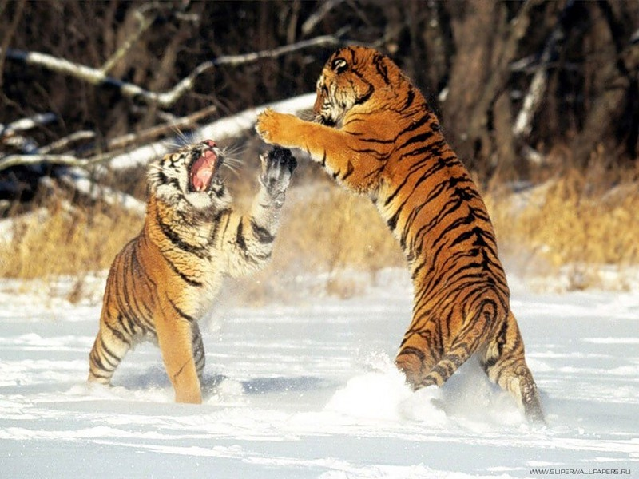
Tiger (s)

Slide 3
Tigers
They are black and orange.
They have got a nose, eyes, a mouth with big teeth and a tail.
They live in India, Africa and South America.
Tigers eat meat.
They can run, jump and swim.
In the picture tigers are playing.

Slide 4
Let us describe other animals

Slide 5
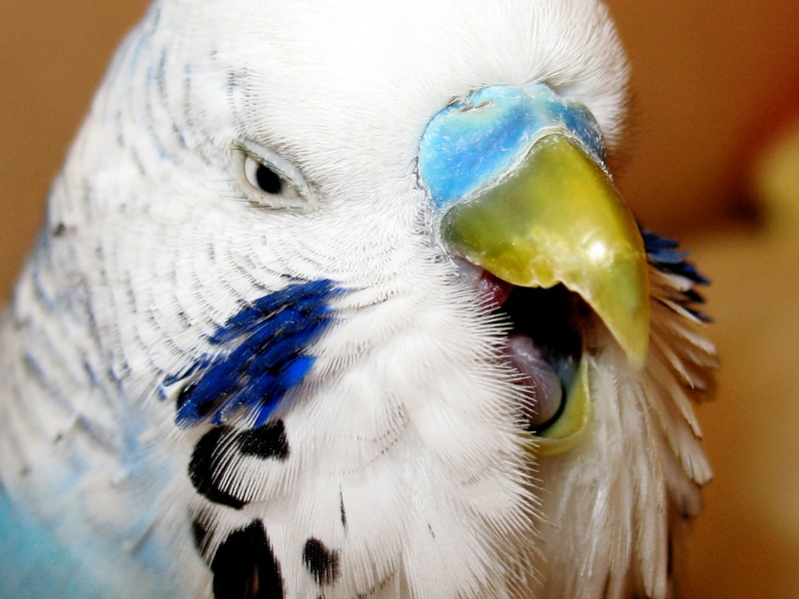
parrot

Slide 6
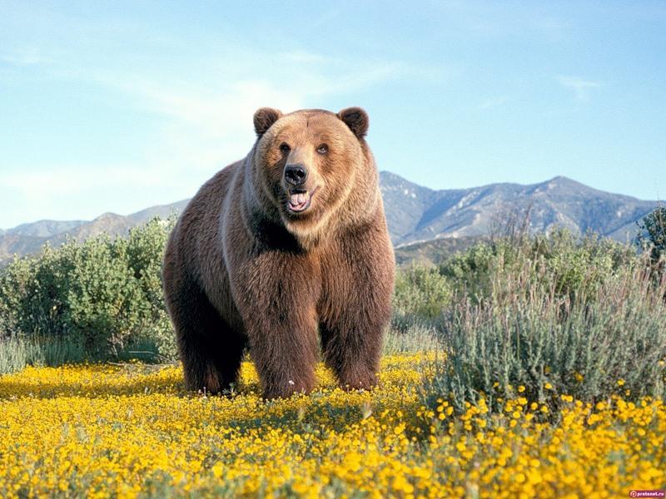
bear

Slide 7
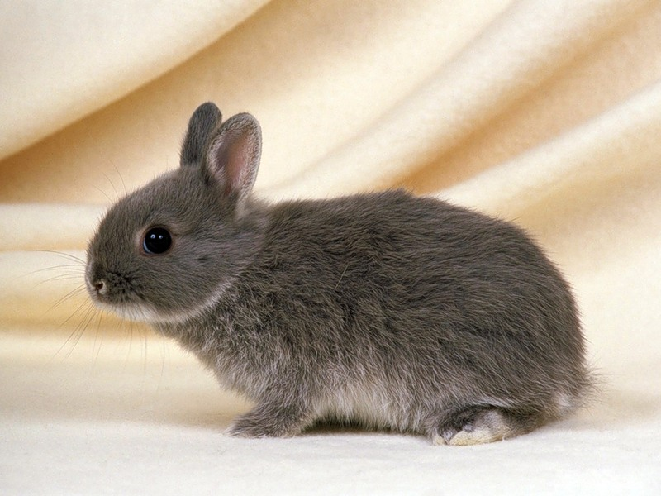
rabbit

Slide 8
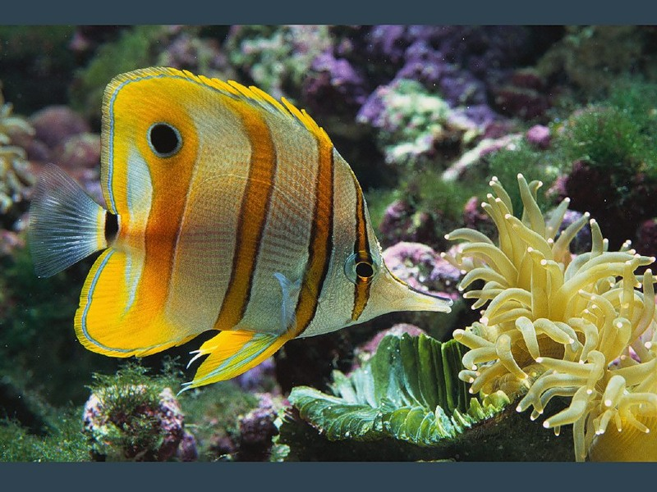
fish

Slide 9
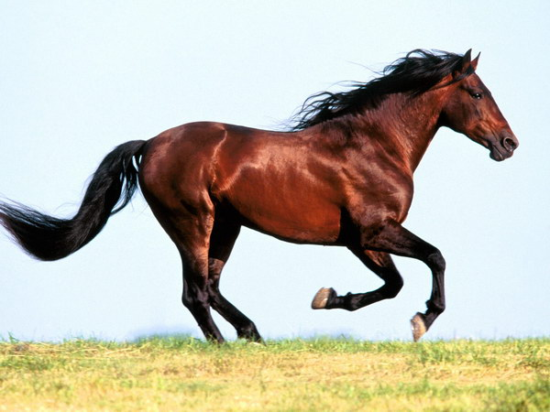
horse

Slide 10
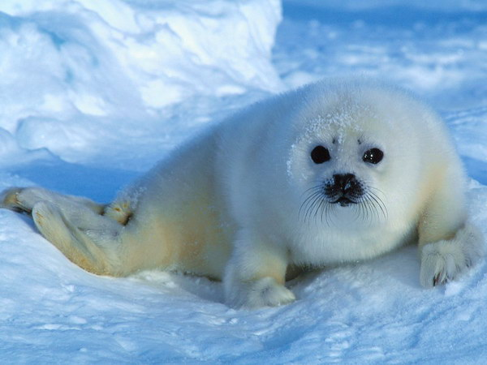
seal

Slide 11
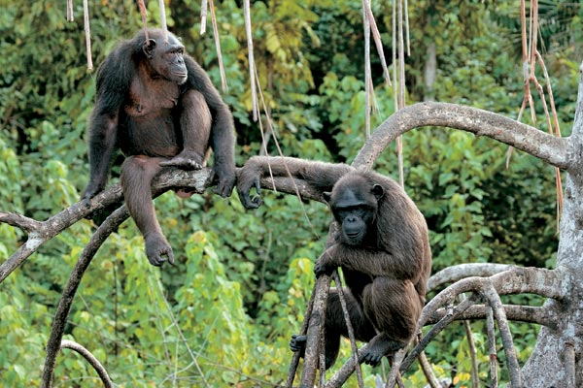
monkeys

Slide 12
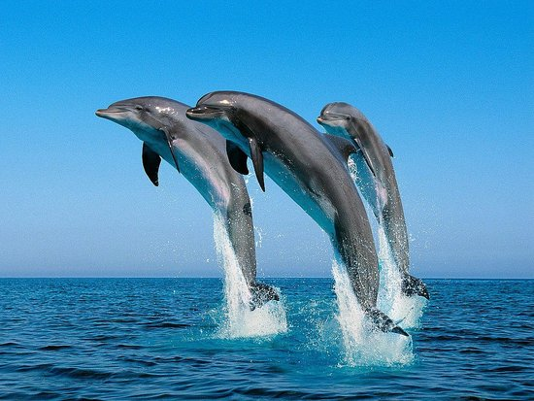
dolphins

Slide 13
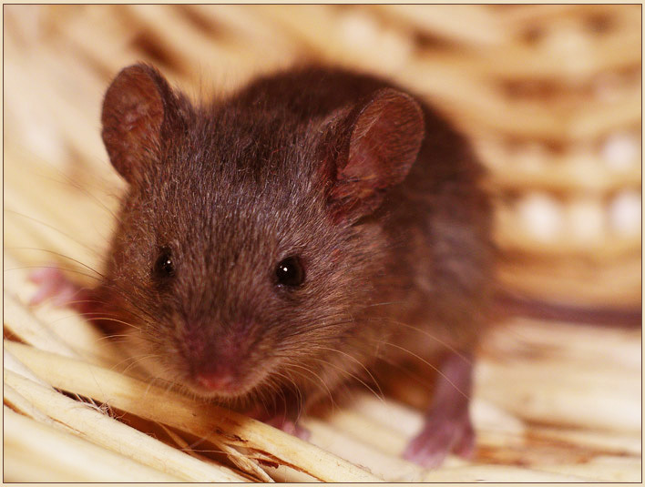
mouse

Slide 14
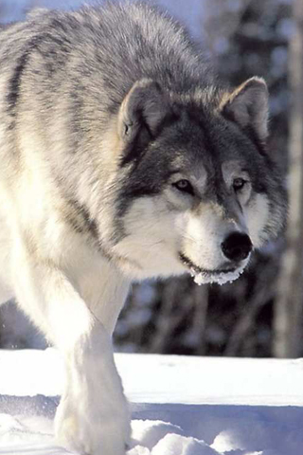
wolf

Slide 15
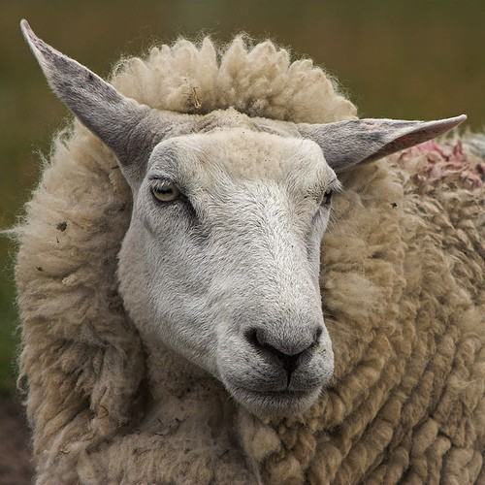
sheep

Slide 16
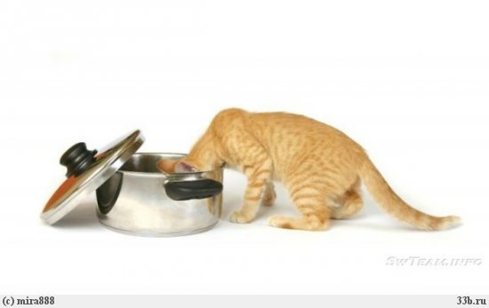
cat

Slide 17
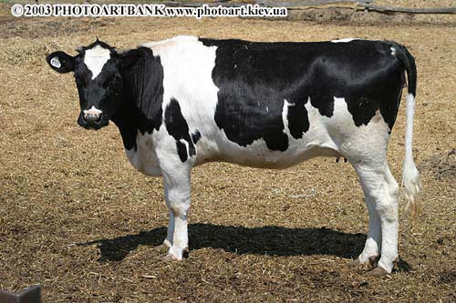
cow

Slide 18
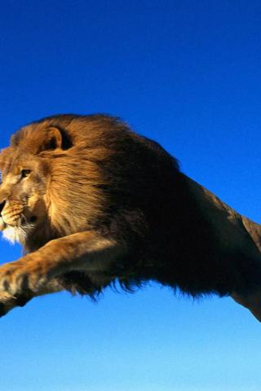
lion

Slide 19
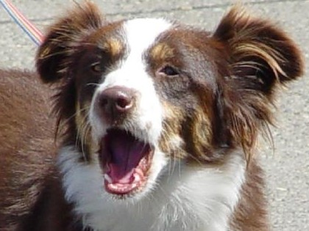
dog

Slide 20
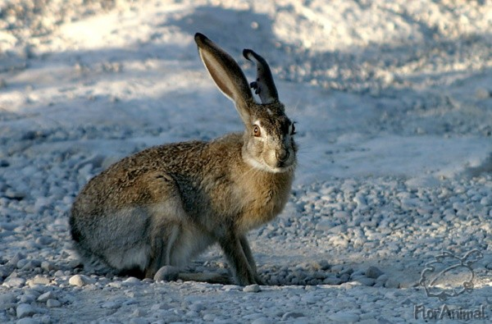
hare

Slide 21
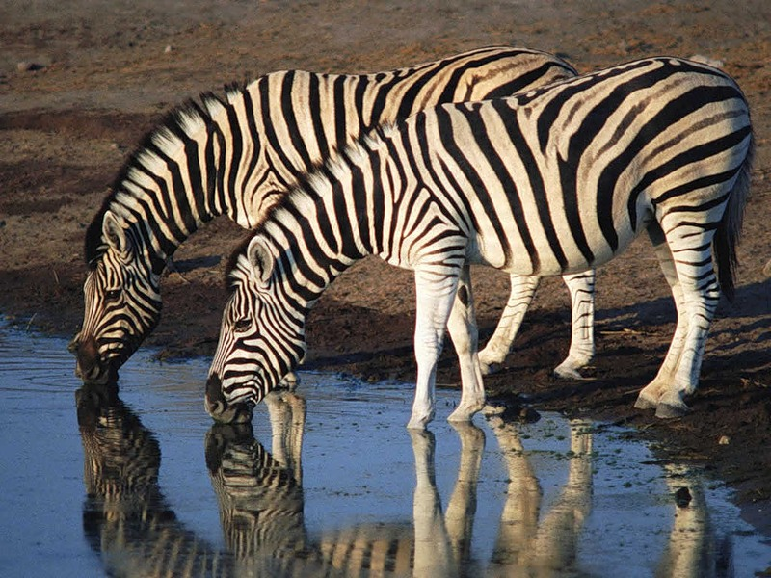
zebra

Slide 22
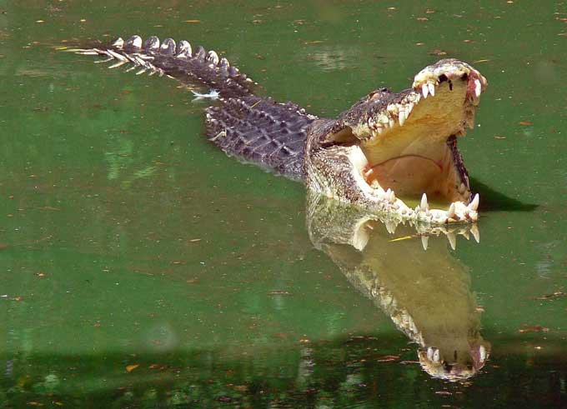
crocodile

Slide 23
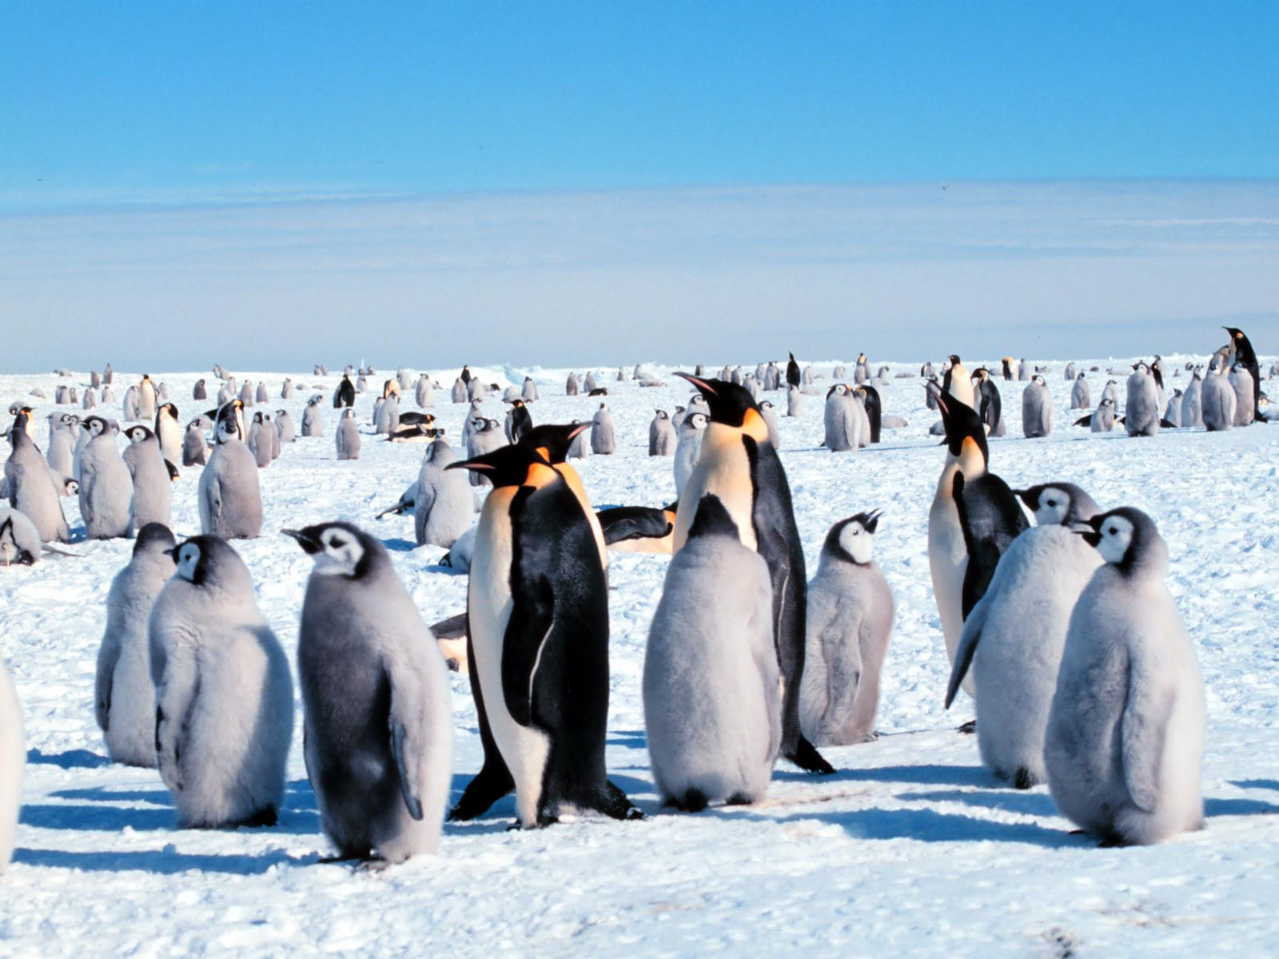
Penguins

Slide 24
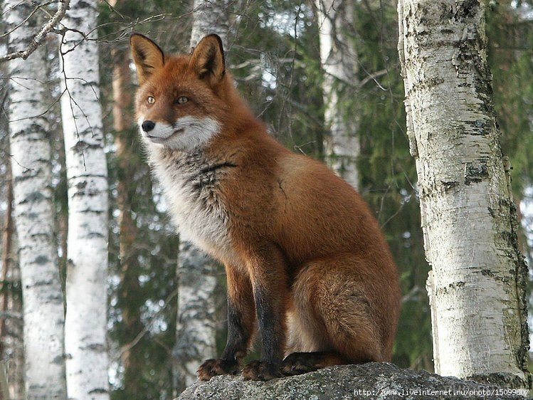
fox

Slide 25
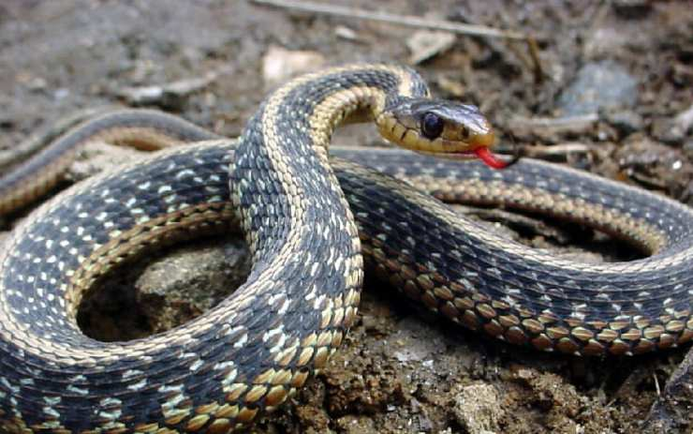
snake

Slide 26
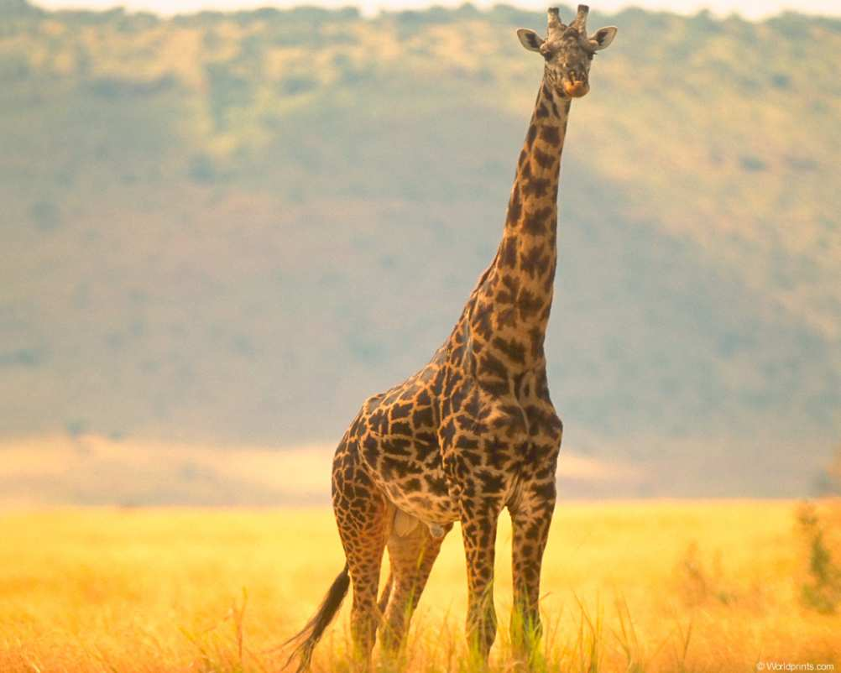
Giraffe

Slide 27
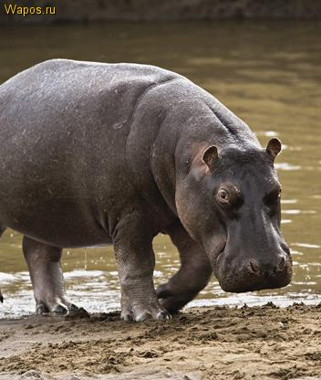
hippo

Slide 28
What is your favourite animal? Describe it. Why do you like it?

